Slide 1
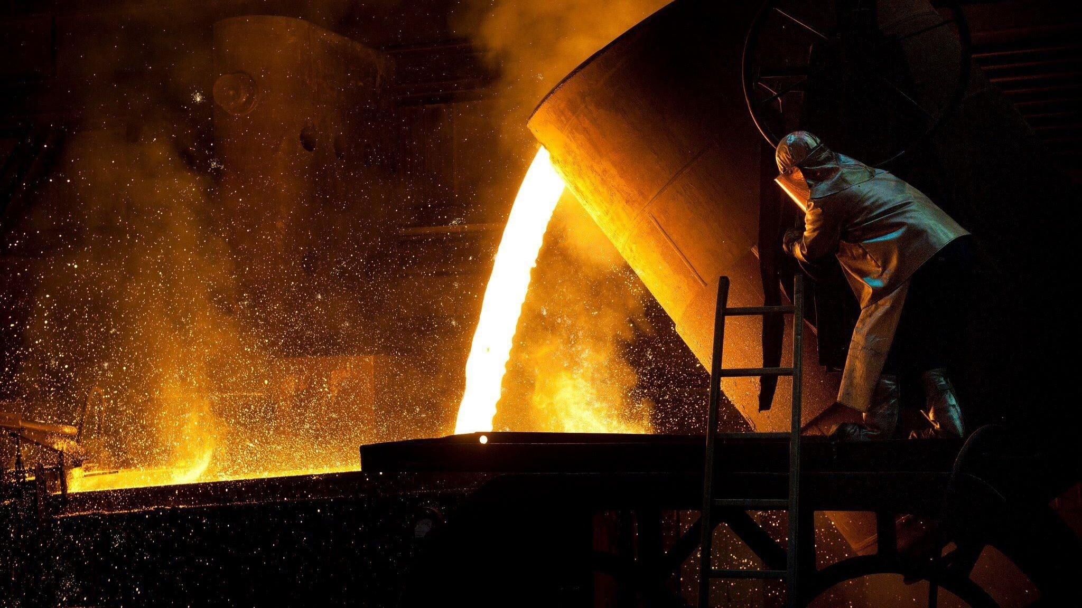
Blacksmith Workshop
Design Document
Mohamed Emad Younis

Slide 2
Overview
Using VR technology in engineering education to facilitate the explanation for students in engineering colleges, especially the preparatory grade students, in the subjects they are studying for the first time, such as manufacturing and production engineering, to identify different machines and tools in a simplified manner.

Slide 3
Among several workshops I chose Blacksmith to be the first version of this project due to several reasons:
All of us know about this workshop and this will help understand the idea of this project and its parts.
Also, It’s components can be imported or modeled easily than the other workshop like milling, drilling and turning processes.

Slide 4
Scenes
A start scene, you Can interact using Raycasting.
User will find himself outside an old building consists of only one floor as it is our blacksmith workshop.
By interaction, user can teleport inside and outside the workshop in its backyard and see from different directions.
Inside the building, user can interact by grabbing metal objects and forging them by the hammers.
An anvil is positioned as a support for forging metals.

Slide 5
Themes
The workshop is coated with some fences and a metal gate.
A metal work is positioned in the front yard as a product.
Inside the building there are some hammers with different size and material.
Some metal parts to test on it.
An anvil is positioned as a support for forging metals by hammers.
Also, A furnace as a view, but its main function is to melt metals.

Slide 6
Flow
First, A start scene, user can interact by using raycasting.
User will find himself outside an old building, then he can teleport to enter inside passing through a beautiful high-poly gate.
Then, He can either explore its backyard or enter the building of this workshop.
Inside the building, there is some tools like Hammers with different size, Anvil, Furnace, a welding machine and some other tools and metal things.
User can grab the hammer and a metal object and hit it on the anvil. (Forging process).
He can learn by recognizing these different tools and the scene.

Slide 7
Graphics
A high-poly gate
A high-poly metal work
A fire positioned in a furnace.
6 cylindrical lamps outside and inside the workshop (5 white color and 1 red)
3 spheric lamps outside the building in the backyard.

Slide 8
Audio
A sound effect when you hit some metal objects with a hammer.

Slide 9
Note
Because time shortage and other reasons, I couldn’t develop the welding process, but I add its machine and tools to express this operation.

